Slide 1
Dividing a quantity into a given ratio
Understanding multiplicative relationships: fractions and ratio

Slide 2
how to use Oak lessons

Slide 3
I can divide one quantity into a given ratio.

Slide 4
Variables are in proportion if they have a constant multiplicative relationship.
A ratio shows the relative sizes of 2 or more values and allows you to compare a part with another part in a whole.

Slide 5

Dividing a quantity into a given ratio
Bar models
Using efficient methods to share in a ratio

Slide 6
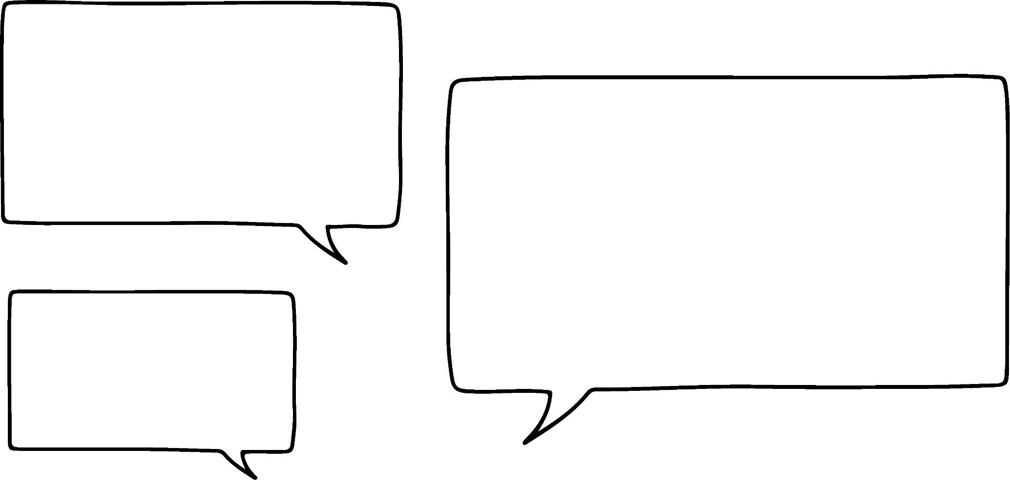
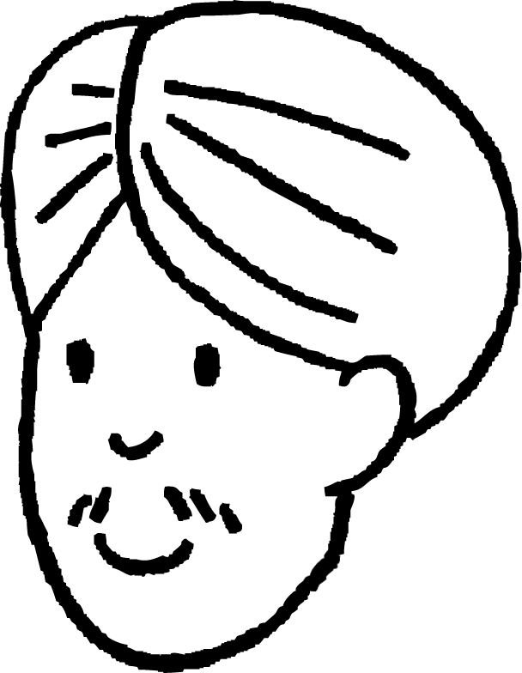

Bar models
Andeep and Sam decide to earn some pocket money.
They are paid £15.
Andeep worked for 2 hours and Sam worked for 3 hours.
We will each get £7.50.
That isn’t fair as I did more hours.
Do you agree with Sam?
Andeep
I agree with Sam.
Sam

Slide 7
Bar models
How can Andeep and Sam share the money fairly?
They could work out the pay for 1 hour.
£15 ÷ 5 = £3 per hour
So, that means we need to divide the pay by 5.
In total we worked 5 hours.
And I get £9.
So, I get £6.
Andeep
Sam

Slide 8
Bar models
We could have represented that problem with a ratio.
Andeep and Sam worked in the ratio of 2 hours : 3 hours.
As a bar model it would look like this:
£15 ÷ 5 = £3
£3
£3
£3
£3
£3
Andeep
Sam
2 × £3 = £6
3 × £3 = £9

Slide 9
Bar models
Would it matter if we had set the bar model out this way?
2 × £3 = £6
£15 ÷ 5 = £3
Andeep
£3
£3
£15 in total
Sam
£3
£3
£3
3 × £3 = £9
Both bar models are useful for this type of question.
However, the second one is most useful in other situations.

Slide 10
Bar models
Share 300 in the ratio 2 : 1 : 3
2 × 50 = 100
300 ÷ 6 = 50
Why do we divide by 6?
2
50
50
1 × 50 = 50
Because there are 6 equal parts in total and we are sharing the total amount.
1
50
300
3 × 50 = 150
3
50
50
50

Slide 11
Bar models
Share 63 in the ratio 5 : 2
Share 55 in the ratio 4 : 7
5 × 9 = 45
63 ÷ 7 = 9
4 × 5 = 20
55 ÷ 11 = 5
5
9
9
9
9
9
4
5
5
5
5
63
55
2
9
9
7
5
5
5
5
5
5
5
2 × 9 = 18
7 × 5 = 35

Slide 12
Bar models
Use a bar model to answer the following:
Share 24 in the ratio 1 : 2
Share 48 in the ratio 3 : 1
Share 24 in the ratio 1 : 5
Share 48 in the ratio 7 : 1
Share 24 in the ratio 3 : 5

Slide 13
Bar models
2) Use a bar model to answer the following:
Andeep, Sam and Sofia share 80 sweets in the ratio 3 : 8 : 5. How many sweets do they each get?
The perimeter of a triangle is 42.5 cm. The lengths of the sides are in the ratio of 7 : 6 : 4. How long is each side?
The ratio of flour to butter to sugar in a cookie recipe is 3 : 2 : 1. You want to make a giant cookie weighing 510 grams. How much of each ingredient do you need?

Slide 14
Bar models
Use a bar model to answer the following:
Share 24 in the ratio 1 : 2 8 : 16
Share 48 in the ratio 3 : 1 36 : 12
Share 24 in the ratio 1 : 5 4 : 20
Share 48 in the ratio 7 : 1 42 : 6
Share 24 in the ratio 3 : 5 9 : 15

Slide 15
Bar models
2) Use a bar model to answer the following:
Andeep, Sam and Sofia share 80 sweets in the ratio 3 : 8 : 5. How many sweets do they each get?
Andeep = 15, Sam = 40 and Sofia = 25
The perimeter of a triangle is 42.5 cm. The lengths of the sides are in the ratio of 7 : 6 : 4. How long is each side?
17.5 cm : 15 cm : 10 cm
The ratio of flour to butter to sugar in a cookie recipe is 3 : 2 : 1. You want to make a giant cookie weighing 510 grams. How much of each ingredient do you need?
Flour = 255 g, butter = 170 g and sugar = 85 g

Slide 16
Dividing a quantity into a given ratio
Bar models
Using efficient methods to share in a ratio

Slide 17
Using efficient methods to share in a ratio
Andeep and Sofia share their 120 sweets in the ratio of 11 : 9
Would you want to draw a bar model to represent this?
Probably not!
Andeep | Sofia
11 | 9
22 | 18
33 | 27
44 | 36
55 | 45
66 | 54
Total
20
40
60
80
100
120
What does the ratio mean?
That they are not sharing the sweets equally.
Everytime Andeep gets 11 sweets, Sofia gets 9 sweets.
What is the multiplicative relationship between 20 and 120?
× 6

Slide 18

Using efficient methods to share in a ratio
The ratio of orange juice to lemonade in a drink is 3 : 7
Sofia wants to make a large jug of the drink.
The capacity of the jug is 4 litres.
How much orange juice and lemonade should she use?
Orange juice (L) | Lemonade (L)
3 | 7
1.2 | 2.8
Total
10
4
What is the multiplicative relationship between these?
×

Slide 19
Using efficient methods to share in a ratio
The ratio of flour to butter to sugar in a cookie recipe is 3 : 2 : 1
You want to make a giant cookie weighing 450 grams.
How much of each ingredient do you need?
Flour (g) | Butter (g) | Sugar (g)
3 | 2 | 1
225 | 150 | 75
Total
6
450
What is the multiplicative relationship between these?
× 75

Slide 20

Using efficient methods to share in a ratio
Share £64 in the ratio 3 : 10 : 7
Total
20
64
3 | 10 | 7
£9.60 | £32 | £22.40
×

Slide 21
Using efficient methods to share in a ratio
Andeep is mixing pink paint using red and white paint in the ratio of 3 : 5
He needs to make 20 litres of pink paint.
Here are Andeep’s workings.
What mistake has he made?
Red | White
3 | 5
15 | 17
Total
8
20
He has found the additive relationship.

Slide 22
Using efficient methods to share in a ratio
Andeep is mixing pink paint using red and white paint in the ratio of 3 : 5
He needs to make 20 litres of pink paint.
Correct Andeep’s mistake.
Red | White
3 | 5
7.5 | 12.5
Total
8
20
× 2.5

Slide 23
Using efficient methods to share in a ratio
Use a ratio table to answer the following:
Share 36 in the ratio 1 : 2
Share 64 in the ratio 3 : 1
Share 36 in the ratio 1 : 5
Share 64 in the ratio 7 : 1
Share 36 in the ratio 3 : 5

Slide 24
Using efficient methods to share in a ratio
2) Use a ratio table to answer the following:
Andeep, Sam and Sofia share 240 sweets in the ratio 3 : 8 : 5. How many sweets do they each get?
The perimeter of a triangle is 107.1 cm. The lengths of the sides are in the ratio of 7 : 6 : 4. How long is each side?
The ratio of flour to butter to sugar in a cookie recipe is 3 : 2 : 1. You want to make a giant cookie weighing 720 grams. How much of each ingredient do you need?

Slide 25
Using efficient methods to share in a ratio
Use a ratio table to answer the following:
Share 36 in the ratio 1 : 2 12 : 24
Share 64 in the ratio 3 : 1 48 : 16
Share 36 in the ratio 1 : 5 6 : 30
Share 64 in the ratio 7 : 1 56 : 8
Share 36 in the ratio 3 : 5 13.5 : 22.5

Slide 26
Using efficient methods to share in a ratio
2) Use a ratio table to answer the following:
Andeep, Sam and Sofia share 240 sweets in the ratio 3 : 8 : 5. How many sweets do they each get? Andeep = 45, Sam = 120 and Sofia = 75
The perimeter of a triangle is 107.1 cm. The lengths of the sides are in the ratio of 7 : 6 : 4. How long is each side? 44.1 cm : 37.8 cm : 25.2 cm
The ratio of flour to butter to sugar in a cookie recipe is 3 : 2 : 1. You want to make a giant cookie weighing 720 grams. How much of each ingredient do you need? Flour = 360 g, butter = 240 g and sugar = 120 g

Slide 27
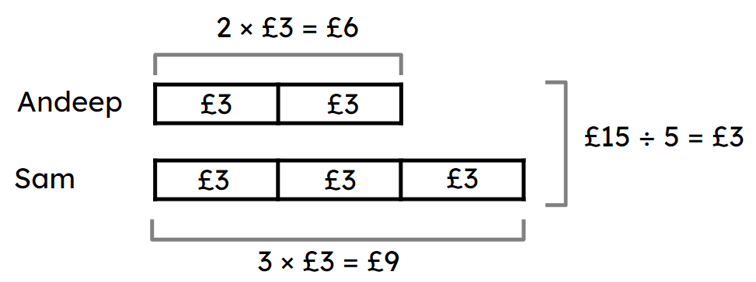
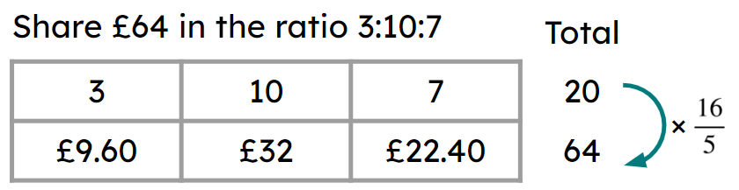
Dividing a quantity into a given ratio
A bar model can be used to share in a given ratio.
E.g.
A more efficient way to share in a given ratio is to use a ratio table.
E.g.

Slide 28

© Oak National Academy 2023.
Produced in partnership with Mathematics in Education and Industry.
Licensed on the Open Government Licence v3.0, except where otherwise stated. See Oak terms and conditions.

